Slide 1
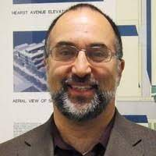
Extensions czar: Michael David Sasson

Slide 2
Website
Website
tentative schedule
lecture slides and notes
course policies, etc.
https://inst.eecs.berkeley.edu/~cs188/fa21
Notes:
Want to use my limited time in the way the contributes most to learning

Slide 3
Piazza
Communication:
piazza – ask and answer questions; announcements
private matters – private messages
if your message is not answered promptly enough, here is the staff email: cs188@berkeley.edu
Exceptional circumstances and DSP extensions: fill out the form https://forms.gle/KqsWouKUhpvVKipXA that goes to the course manager; email eecs-course-management@eecs.berkeley.edu if you want to reach out to them directly with questions

Slide 4
Course Format
Lectures TuTh
I’d love for you to show up and actively engage; participation credit
If you’re comfortable, consider turning your camera on.
Raise your hand to ask question (preferred; chat also ok; use chat to ask each other questions)
Recorded, will upload to bdrive
Slides will be posted after lecture (preliminary slides before)
We’ll have lecture notes too
There are also pre-pandemic webcasts available
Notes:
Interactive style

Slide 5
Course Format
Discussion Sections
schedule on piazza
Pick 1 to go to; show up to it consistently; participation credit
Some videos/walkthroughs will also be posted
Start 9/1
Some sections are “extended” to give more of a chance for recap

Slide 6
Course Format
Exam prep sections
Exams are super hard. We try to prep you for them throughout.
Schedule on piazza
Some videos/walkthroughs will be posted

Slide 7
Course Format (continued)
Homework (autograded portion)
Due Tuesdays at at 10:59pm (except for HW0) (grace period up to 11:59pm)
Exercises based on class material
Get you comfortable with the basics
Solve together, submit alone
Academic integrity!
Autograded, multiple submissions!
I expect you to get 100% on electronic homework
You get to drop 1. *No slip days* -- use drop instead.

Slide 8
Course Format (continued)
Homework (challenge question)
To enable a deeper understanding, we will also include a challenge (exam-level) question
Need to show your work on paper or tablet
graded for correcteness, but you will be able to regain up to 75% of the points by resubmitting after the deadline with a “reflection”
Solve together, submit alone
Academic integrity!

Slide 9
Course Format (continued)
Projects
Due Fridays at 10:59pm
Grace period to 11:59pm
5 projects, groups of 1-2
Academic integrity!
Python
Give you hands-on experience with the algorithms
Also autograded
I expect you to get 100% on projects
5 slip days, max 2 per project
After that, loose 20% per day turned in late

Slide 10
Course Format (continued)
Contests
Submit your own agents to do cool creative things!!
Give you a chance to exercise going from a problem statement to devising your own solution based on algorithms you know
Give your agents cool names!
AlphaGhost
myTeam.py
extracredit plz try 2
Eh
Shotsandgoggles
Pieter <3 Anca 4 Life

Slide 11
Course Format (continued)
Exams
Thursday, Oct 14 7-9pm Midterm
Thursday, Dec 16 11:30am-2:30pm Final Exam
Exams are the main assessment tool, so they are hard
Exam practice sessions!
Written homework, exam style!

Slide 12
Course Format (continued)
Office hours
Schedule is on piazza
GSI and uGSI: concepts, projects, homework
Anca/Pieter: concepts, high level guidance

Slide 13
Prerequisites
61A and 61B and 70
math
There is a math self diagnostic test on gradescope – take it! (not graded)
programming
There is a 0th project (P0) – mandatory

Slide 14
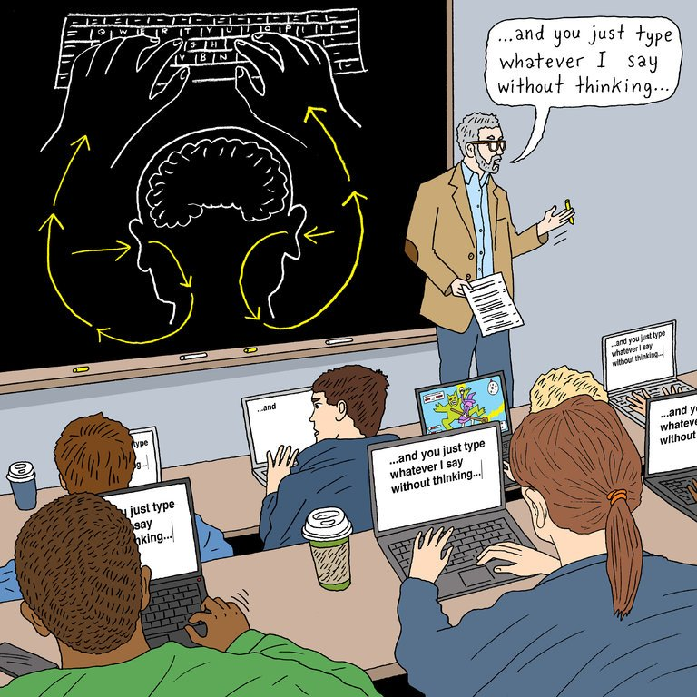

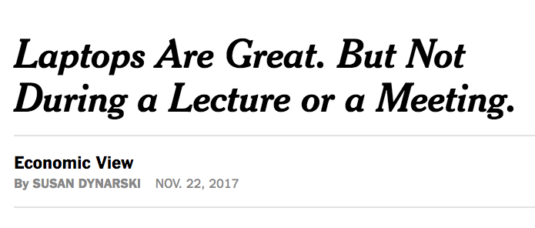
I used to say: Laptops in Lecture

Slide 15
Laptops in Lecture
(starting next lecture)
I prefer if you don’t use laptops or phones in lecture.
If you really want to use a laptop, sit in the back.
(everyone else -- I encourage you to sit in the front so that we can have an interaction.)

Slide 16
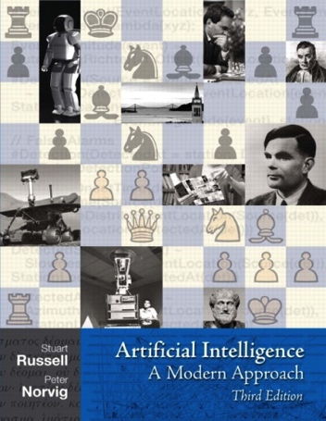
Textbook
Not required, but for students who want to read more we recommend
Russell & Norvig, AI: A Modern Approach
Warning: Not a course textbook, so our presentation does not necessarily follow the presentation in the book.

Slide 17
Build a great community
Help out your peers on piazza and in meetings!
Be mindful of the tone you use – be respectful and supportive, help everyone feel at home.
Watch out for implicit bias.
Someone’s gender, race, ethnicity, sexual orientation, etc. do NOT have anything to do with how awesome they will be in this class.
Having a ton of programming experience will help some with projects, but does NOT give anyone an edge on how well they can understand the material and how highly they can score on the exams.
Please talk to me/Pieter if something we or the GSIs do makes you uncomfortable!

Slide 18
Important This Week
Important this week:
Register for the class on gradescope
Register for the class on piazza --- our main resource for discussion and communication
P0: Python tutorial is out ; due Monday 8/30 at 10:59pm; project party Friday 3-5pm in Soda 411
Math self-diagnostic is out --- important to check your preparedness for second half
Mark exam dates in your calendars
Also important:
Sections start next week (exam prep will cover regular session material the first week)
If you are wait-listed, you might or might not get in depending on how many students drop.
Office Hours start next week.
Notes:
The waiting list will take a while to sort out. We don’t control enrollment. Contact cindy conners

Slide 19
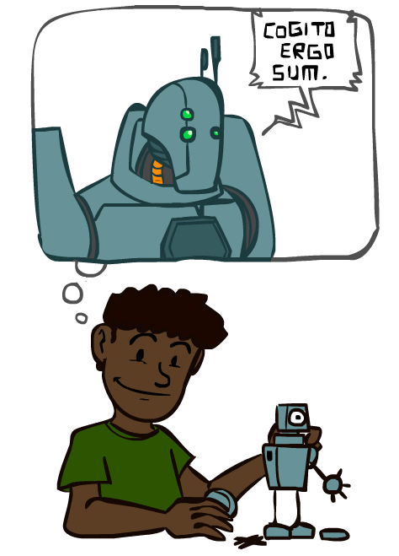
A (Short) History of AI

Slide 20


Slide 21
A (Short) History of AI
1940-1950: Early days
1943: McCulloch & Pitts: Boolean circuit model of brain
1950: Turing's “Computing Machinery and Intelligence”
1950—70: Excitement: Look, Ma, no hands!
1950s: Early AI programs, including Samuel's checkers program, Newell & Simon's Logic Theorist, Gelernter's Geometry Engine
1956: Dartmouth meeting: “Artificial Intelligence” adopted
1965: Robinson's complete algorithm for logical reasoning
1970—90: Knowledge-based approaches
1969—79: Early development of knowledge-based systems
1980—88: Expert systems industry booms
1988—93: Expert systems industry busts: “AI Winter”
1990—: Statistical approaches
Resurgence of probability, focus on uncertainty
General increase in technical depth
Agents and learning systems… “AI Spring”?
2000—: Where are we now?
Notes:
Computation with circuits, brain was like a bunch of circuits
Less computation than your watch; could barely do anything , but we thought we’re right there
Write stuff down, they start contradicting; winter
Statistics, uncertainty
Computation with artificial neurons, brain was like a bunch of real neurons ☺

Slide 22
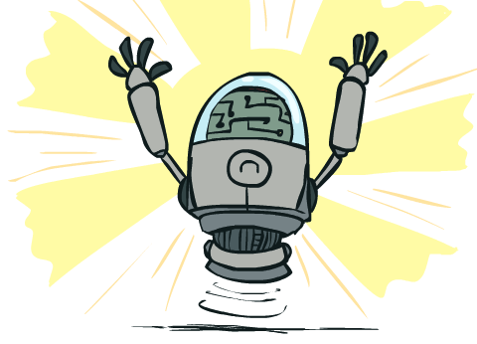
What Can AI Do?
Quiz: Which of the following can be done at present?
Play a decent game of Jeopardy?
Win against any human at chess?
Win against the best humans at Go?
Play a decent game of tennis?
Grab a particular cup and put it on a shelf?
Unload any dishwasher in any home?
Drive safely along the highway?
Drive safely along Telegraph Avenue?
Buy a week's worth of groceries on the web?
Buy a week's worth of groceries at Berkeley Bowl?
Discover and prove a new mathematical theorem?
Perform a surgical operation?
Unload a know dishwasher in collaboration with a person?
Translate spoken Chinese into spoken English in real time?
Write an intentionally funny story?

Slide 23
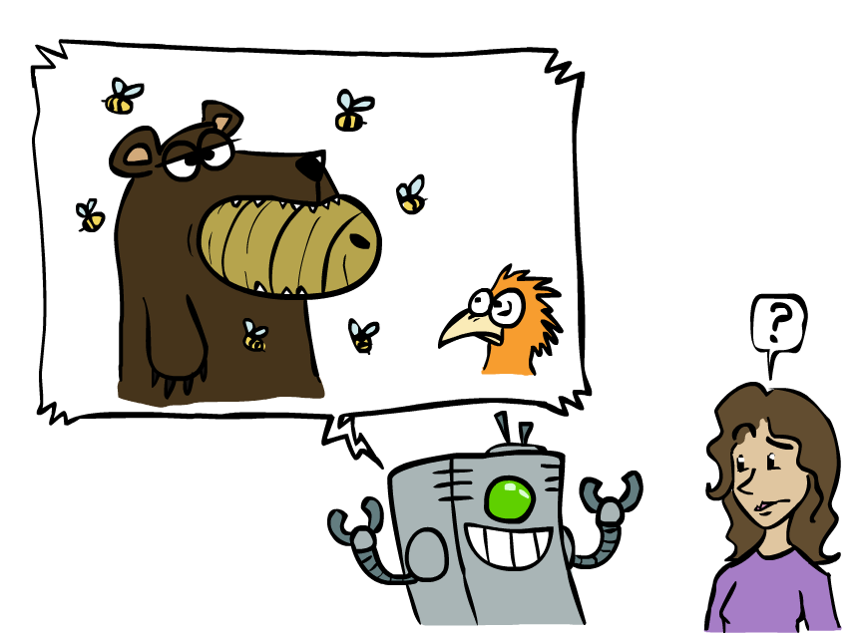
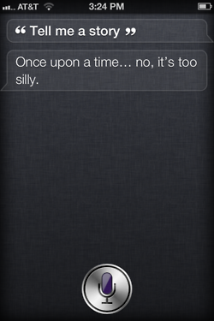

Unintentionally Funny Stories
One day Joe Bear was hungry. He asked his friend
Irving Bird where some honey was. Irving told him
there was a beehive in the oak tree. Joe walked to
the oak tree. He ate the beehive. The End.
Henry Squirrel was thirsty. He walked over to the
river bank where his good friend Bill Bird was sitting.
Henry slipped and fell in the river. Gravity drowned.
The End.
Once upon a time there was a dishonest fox and a vain crow. One day the crow was sitting in his tree, holding a piece of cheese in his mouth. He noticed that he was holding the piece of cheese. He became hungry, and swallowed the cheese. The fox walked over to the crow. The End.
[Shank, Tale-Spin System, 1984]
Notes:
1 – physically wrong, shouldn’t eat beehive
2 – forgot that in drowning not the force is most important but the drownee
3 – not physically wrong, not wrong in a language way, but wrong in the sense that it’s not aware of what is relevant to communicate and what is not
Siri – is that progress?

Slide 24
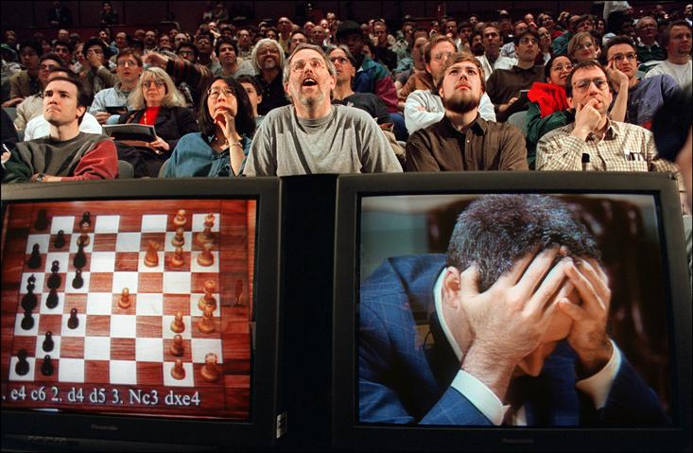

Slide 25
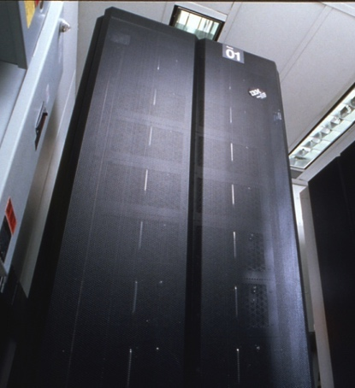
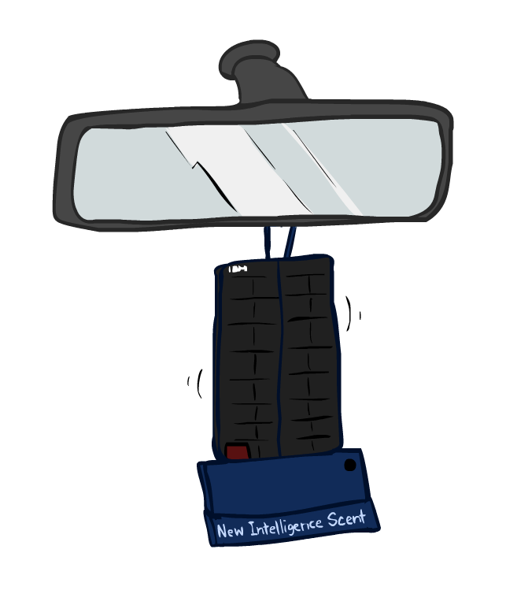
Game Agents
Classic Moment: May, '97: Deep Blue vs. Kasparov
First match won against world champion
“Intelligent creative” play
200 million board positions per second
Humans understood 99.9 of Deep Blue's moves
Can do about the same now with a PC cluster
1996: Kasparov Beats Deep Blue
“I could feel --- I could smell --- a new kind of intelligence across the table.”
1997: Deep Blue Beats Kasparov
“Deep Blue hasn't proven anything.”
Text from Bart Selman, image from IBM’s Deep Blue pages
Notes:
Yeah, Kasparov comment probably says more about humans than about computers

Slide 26
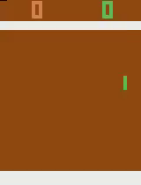
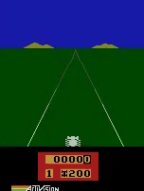
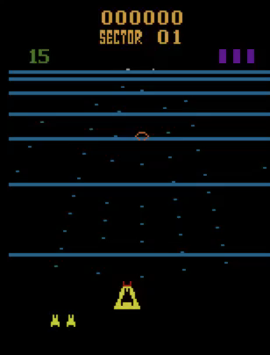
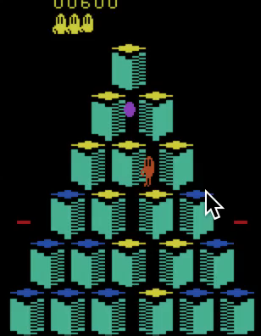
Game Agents
Reinforcement learning
Pong
Enduro
Beamrider
Q*bert

Slide 27
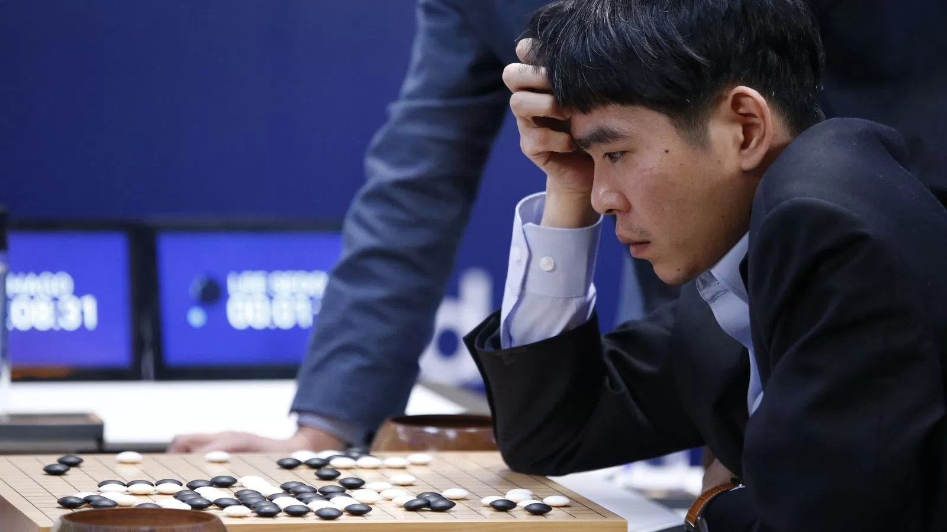
Game Agents
Reinforcement learning

Slide 28
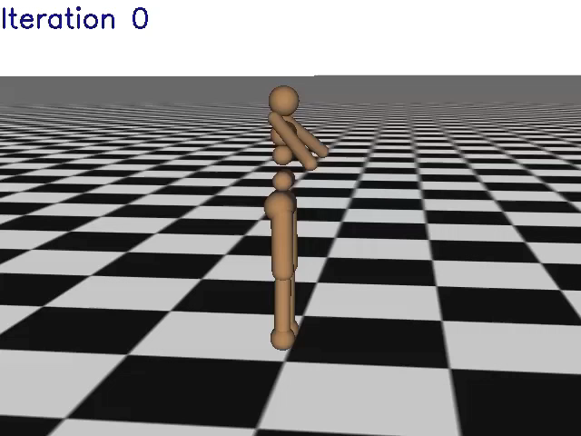
Simulated Agents
[Schulman, Moritz, Levine, Jordan, Abbeel, ICLR 2016]

